Slide 1
Dual Data Cache
Veljko Milutinovic
vm@etf.bg.ac.rs
University of Belgrade
School of Electrical Engineering
Department for Computer Engineering

Slide 2
Content
Introduction
The basic idea
Terminology
Proposed classification
Existing solutions
Conclusion

Slide 3
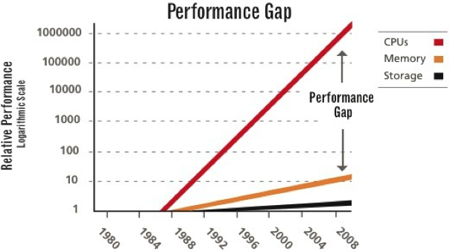
Introduction
Disparity between processor and main memory continues to grow
Design of cache system has a major impact on the overall system performance

Slide 4
The basic idea
Different data get cached differently:
Use several cache sub-systems
Use several prefeching strategies
Use several replacement strategies
One criterion - data locality:
Temporal
Spatial
None

Slide 5
Terminology
Locality prediction table (LPT)
2D spatial locality
Prefetching algorithms
Neighboring
OBL
Java processor (JOP)

Slide 6
Proposed classification (1)
Classification criteria:
General vs. Special-Purpose
Uniprocessor vs. Multiprocessor
Compiler-Assisted vs. Compiler-Not-Assisted
Choice of classification relies on the possibility to classify all existing systems into the appropriate non-overlapping subset of systems

Slide 7
Proposed classification (2)
Successive application of the chosen criteria generates a classification tree
Three binary criteria equals 8 classes
Seven classes include examples from open literature
Only one class does not include known implementations

Slide 8
Proposed classification (3)
The classification three of Dual Data Cache systems. Legend: G/S – general vs. special purpose; U/M – uniprocessor vs. multiprocessor; C/N - compiler assisted vs. hardware; GUC, GUN, GMC, GMN, SUC, SUN, SMC, SMN – abbreviation for eight classes of DDC.

Slide 9
Existing solutions

Slide 10
General Uniprocessor Compiler-Not-assisted (GUN)

Slide 11
The Dual Data Cache (1)
Created in order to resolve four main issues, regarding data cache design:
Large working sets
Pollution due to non-unit stride
Interferences
Prefetching
Simulation results show better performance compared to conventional cache systems

Slide 12
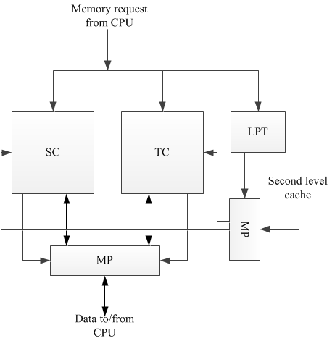
The Dual Data Cache (2)
The Dual Data Cache system. Legend: CPU – central processing unit; SC – spatial sub-cache; TC - temporal sub-cache; LPT – locality prediction table.

Slide 13
The Split Temporal/Spatial Data Cache (1)
Attempt to reduce cache size and power consumption
Possibility to improve performance by using compile-time and profile-time algorithms
Performance similar to conventional cache systems

Slide 14
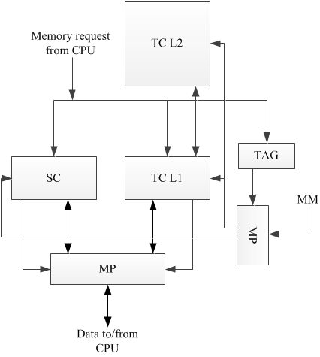
The Split Temporal/Spatial Data Cache (2)
The Split Temporal Spatial cache system. Legend: MM – main memory; CPU – central processing unit; SC – spatial sub-cache with prefetching mechanism; TC L1 and TC L2– the first and second level of the temporal sub-cache; TAG – unit for dynamic tagging/retagging data.

Slide 15
General Uniprocessor Compiler-assisted (GUC)

Slide 16
The Northwestern Solution (1)
Mixed software/hardware technique
Compiler inserts instructions to turn on/off hardware based on selective caching
Better performance than other pure-hardware and pure software techniques
Same size and power consumption

Slide 17
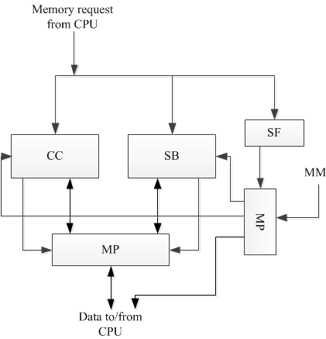
The Northwestern Solution (2)
The Northwestern solution. Legend: CPU - central processing unit, CC - conventional cache, SB - small FIFO buffer, SF - unit for detection of data frequency access and if data exhibit spatial locality , MM - main memory, MP - multiplexer.

Slide 18
General Multiprocessor Compiler-Not-assisted (GMN)

Slide 19
The Split Data Cache in Multiprocessor System (1)
Caches system for SMP environment
Snoop based coherence protocol
Smaller and less power hungry than convention cache system
Better performance compared to conventional cache system

Slide 20
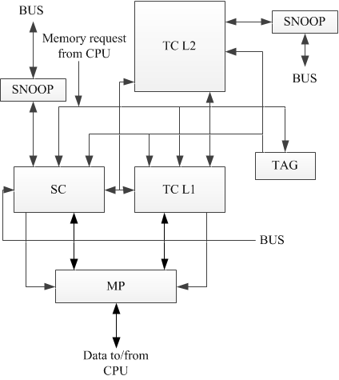
The Split Data Cache in Multiprocessor System (2)
The Split Data Cache system in Multiprocessor system. Legend: BUS – system bus; CPU – central processing unit; SC – spatial sub-cache with prefetching mechanism; TC L1 and TC L2 – the first and second level of the temporal sub-cache; TAG – unit for dynamic tagging/retagging data; SNOOP – snoop controller for cache coherence protocol.

Slide 21
General Multiprocessor Compiler-assisted (GMC)

Slide 22
GMC
GMC class does not include a known implementation
GMC class represents a potentially fruitful research target

Slide 23
Special Uniprocessor compiler-not-assisted (SUN)

Slide 24
The Reconfigurable Split Data Cache (1)
Attempt to utilize a cache system for purposes other than conventional caching
The unused cache part can be turned off
Adaptable to different types of applications

Slide 25
The Reconfigurable Split Data Cache (2)
The Reconfigurable Split Data Cache. Legend: AC – array cache, SC – scalar cache, VC – victim cache, CSR – cache status register, X – unit for determining data-type, L2 – second level cache, MP – multiplexer.

Slide 26
Special uniprocessor Compiler-assisted (SUC)

Slide 27
The Data-type Dependent Cache for MPEG Application (1)
Exploits 2D spatial locality
Unified cached
Different prefetching algorithms based on data locality
Power consumption and size are not considered a limiting factor

Slide 28
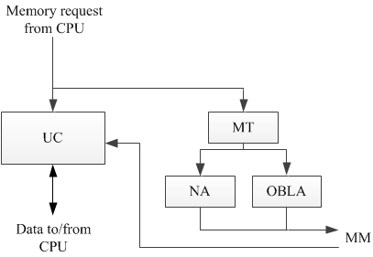
The Data-type Dependent Cache for MPEG Application (2)
The data-type dependent cache for MPEG applications. Legend: UC – unified data cache; MT – memory table for image information; NA – unit for prefetching data by the Neighbor algorithm; OBLA - unit for prefetching data by the OBL algorithm; MM – main memory.

Slide 29
Special multiprocessor Compiler-not-assisted (SMN)

Slide 30
The Texas Solution (1)
Locality determined based on data type
FIFO buffer for avoiding cache pollution
First level cache
Second level conventional cache with a snoop protocol
Smaller size and power consumption than conventional cache systems

Slide 31
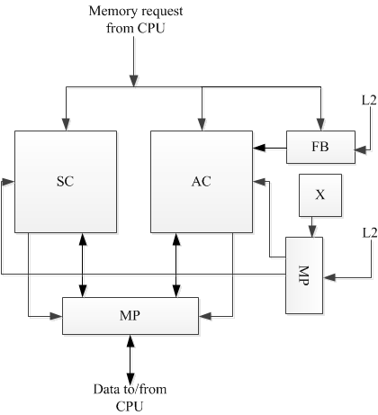
The Texas Solution (2)
The Texas solution cache. Legend: AC – array cache; SC – scalar cache; FB– FIFO buffer; X – unit for determining data-type; L2 – second level cache; MP – multiplexer.

Slide 32
Special Multiprocessor Compiler-assisted (SMC)

Slide 33
The Time-Predictable Data Cache (1)
Cache for multiprocessor system, based on JOP cores
Adapted for real-time analysis
Compiler choses where will data be cached, based on the type of data
Complexity and power are reduced, compared to conventional approach

Slide 34
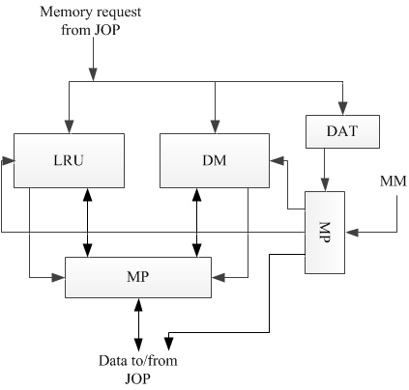
The Time-Predictable Data Cache (2)
The Time-Predictable data cache. Legend: MM – main memory; JOP – Java processor; MP – multiplexer; LRU – fully associative sub-cache system with LRU replacement; DM – direct mapped sub-cache system; DAT – unit for determining data memory access type.

Slide 35
Conclusion
Different solutions for different applications
Less power and less space, while retaining same performance
Better cache utilization
Cache technique for new memory architectures

Slide 36
Thank You!

Slide 37
Questions?
vm@etf.bg.ac.rs

